Slide 1
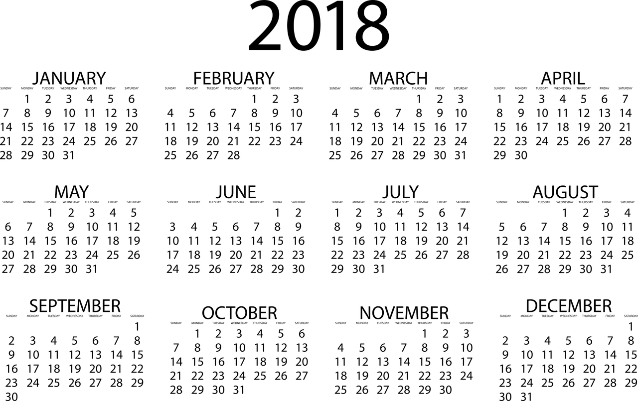
What Will You Do in the New Year?
Notes:
Decided today to bring a New Year’s Resolution sermon, but a bit different take on it.
Tonight is our regularly schedule lesson on the Theme “About My Father’s Business”
Next Sunday morning (Jeremiah Cox) / Sunday night our Quarterly Song Service (Great way to end the year!)
Introduce lesson by sharing with you a free verse poem written by (as I understand it) a young Christian from Nebraska, who passed away after a long struggle against a malignant brain tumor at the age of 16. He died in April of 2009.
Considering his passing at such a young age, the sentiments expressed by the wise man in Ecclesiastes 9:10 is especially poignant.
(Ecclesiastes 9:10), “Whatever your hand finds to do, do it with your might; for there is no work or device or knowledge or wisdom in the grave where you are going.”
Here is the poem, (with apologies for the small font. Feel free to get a copy of the handout in the foyer).

Slide 2
This year I want to…
Write something worth reading
Read something worth sharing
Say something worth repeating
Give something worth getting
Choose something worth keeping
Sacrifice something worth giving up
Go somewhere worth seeing
Eat something worth tasting
Hug someone worth holding
Buy something worth treasuring
Cry tears worth shedding
Do something worth watching
Risk something worth protecting
Listen to someone worth hearing
Teach something worth learning
Be someone worth knowing
- Kelsey Harris (16)
Notes:
This year I want to...
Write something worth reading / Read something worth sharing / Say something worth repeating / Give something worth getting / Choose something worth keeping / Sacrifice something worth giving up / Go somewhere worth seeing / Eat something worth tasting / Hug someone worth holding / Buy something worth treasuring / Cry tears worth shedding / Do something worth watching / Risk something worth protecting / Listen to something worth hearing / Teach something worth learning / Be someone worth knowing. (Kelsey Harris, 16).
While all are laudable goals (Travel and appreciation for good food certainly appropriate, especially as we consider how short our lives are). We want to make a spiritual application of 8 of the phrases Kelsey used this in this poem.

Slide 3
This year I want to…
READ something worth SHARING
2 Timothy 2:15; Psalm 119:9-16; 1 Timothy 4:16
Notes:
READ Something worth SHARING (GOD’s LAW)
Worthy efforts by man (fiction, non-fiction, motivational, self-help, humor, etc.)
Nothing more important than reading the word of God
(KJV - 2 Timothy 2:15), “Study to shew thyself approved unto God, a workman that needeth not to be ashamed, rightly dividing the word of truth.”
The Law of the Lord is perfect! Nothing that you read within it could be surpassed in its worthiness to share with others.
(Psalm 119:9-16), “How can a young man cleanse his way? By taking heed according to Your word. ¹⁰ With my whole heart I have sought You; Oh, let me not wander from Your commandments! ¹¹ Your word I have hidden in my heart, That I might not sin against You. ¹² Blessed are You, O Lord! Teach me Your statutes. ¹³ With my lips I have declared All the judgments of Your mouth. ¹⁴ I have rejoiced in the way of Your testimonies, As much as in all riches. ¹⁵ I will meditate on Your precepts, And contemplate Your ways. ¹⁶ I will delight myself in Your statutes; I will not forget Your word.”
By sharing it, you may save others!
(1 Timothy 4:16), “Take heed to yourself and to the doctrine. Continue in them, for in doing this you will save both yourself and those who hear you.”

Slide 4
This year I want to…
READ something worth SHARING
2 Timothy 2:15; Psalm 119:9-16; 1 Timothy 4:16
SAY something worth REPEATING
Matthew 28:18-20; 2 Timothy 2:1-2; Colossians 4:6
Notes:
SAY something worth REPEATING (EVANGELIZE)
This is the command given by Jesus in His great commission to His disciples
(Matthew 28:18-20), “And Jesus came and spoke to them, saying, “All authority has been given to Me in heaven and on earth. ¹⁹ Go therefore and make disciples of all the nations, baptizing them in the name of the Father and of the Son and of the Holy Spirit, ²⁰ teaching them to observe all things that I have commanded you; and lo, I am with you always, even to the end of the age.” Amen.”
A primary purpose of our studies during worship is to equip each of us to repeat these things to others!
(2 Timothy 2:1-2), “You therefore, my son, be strong in the grace that is in Christ Jesus. ² And the things that you have heard from me among many witnesses, commit these to faithful men who will be able to teach others also.”
Also, as an aside, it is important that we speak pure and graceful words, lest we be ashamed!
(Colossians 4:6), “Let your speech always be with grace, seasoned with salt, that you may know how you ought to answer each one.”

Slide 5
This year I want to…
READ something worth SHARING
2 Timothy 2:15; Psalm 119:9-16; 1 Timothy 4:16
SAY something worth REPEATING
Matthew 28:18-20; 2 Timothy 2:1-2; Colossians 4:6
CHOOSE something worth KEEPING
Luke 10:41-42; Matthew 13:45-46
Notes:
CHOOSE something worth KEEPING (The KINGDOM OF GOD/SALVATION)
Mary (the sister of Lazarus, and Jesus’ friend) chose “that good part”
(Luke 10:41-42) [Jesus answered Martha’s request that Mary help in the serving rather than sit at Jesus’ feet to hear His words], “And Jesus answered and said to her, “Martha, Martha, you are worried and troubled about many things. ⁴² But one thing is needed, and Mary has chosen that good part, which will not be taken away from her.”
Mary’s interest was in spiritual things. Things that could bring her eternal salvation!
(Matthew 13:45-46), ““Again, the kingdom of heaven is like a merchant seeking beautiful pearls, ⁴⁶ who, when he had found one pearl of great price, went and sold all that he had and bought it.”
Nothing is more important than the kingdom of heaven. If you choose it, and hold on to it, you will never regret it!

Slide 6
This year I want to…
READ something worth SHARING
2 Timothy 2:15; Psalm 119:9-16; 1 Timothy 4:16
SAY something worth REPEATING
Matthew 28:18-20; 2 Timothy 2:1-2; Colossians 4:6
CHOOSE something worth KEEPING
Luke 10:41-42; Matthew 13:45-46
SACRIFICE something worth GIVING UP
Romans 12:1-2; 2 Corinthians 8:5,12
Notes:
SACRIFICE something worth GIVING UP (Sacrifice SELF)
Consider the implication of Paul’s admonition
(Romans 12:1-2), “I beseech you therefore, brethren, by the mercies of God, that you present your bodies a living sacrifice, holy, acceptable to God, which is your reasonable service. ² And do not be conformed to this world, but be transformed by the renewing of your mind, that you may prove what is that good and acceptable and perfect will of God.”
If such a willingness to sacrifice is present, it will impact every aspect of your service to God
(2 Corinthians 8:5) [Paul’s representation of the Macedonians in the realm of giving], “And not only as we had hoped, but they first gave themselves to the Lord, and then to us by the will of God.”
Led to sacrificial giving – Generosity
(2 Corinthians 8:12), “For if there is first a willing mind, it is accepted according to what one has, and not according to what he does not have.”

Slide 7
This year I want to…
HUG someone worth HOLDING
Romans 12:5,10,15-16; 1 John 3:11,14
Notes:
HUG someone worth HOLDING (Love your brethren)
With this I want to impress upon you the importance of loving your brethren
(Romans 12:5,10,15-16a)
(5), “so we, being many, are one body in Christ, and individually members of one another.”
(10), “Be kindly affectionate to one another with brotherly love, in honor giving preference to one another.”
(15-16a), “Rejoice with those who rejoice, and weep with those who weep. ¹⁶ Be of the same mind toward one another…”
The command to love one another has been God’s imperative from the beginning
(1 John 3:11,14)
(11), “For this is the message that you heard from the beginning, that we should love one another.”
(14), “We know that we have passed from death to life, because we love the brethren.”

Slide 8
This year I want to…
HUG someone worth HOLDING
Romans 12:5,10,15-16; 1 John 3:11,14
BUY something worth TREASURING
Proverbs 23:23; John 8:31-32; Jude 3
Notes:
BUY something worth TREASURING (The TRUTH)
(Proverbs 23:23), “Buy the truth, and sell it not; also wisdom, and instruction, and understanding.”
Truth of any type is important (Math, medicine, testimony, etc.)
Spiritual truth is the difference between freedom and bondage!
(John 8:31-32), “Then Jesus said to those Jews who believed Him, “If you abide in My word, you are My disciples indeed. ³² And you shall know the truth, and the truth shall make you free.”
That is why it is so important to fight for the truth of God’s word!
(Jude 3), “Beloved, while I was very diligent to write to you concerning our common salvation, I found it necessary to write to you exhorting you to contend earnestly for the faith which was once for all delivered to the saints.”

Slide 9
This year I want to…
HUG someone worth HOLDING
Romans 12:5,10,15-16; 1 John 3:11,14
BUY something worth TREASURING
Proverbs 23:23; John 8:31-32; Jude 3
LISTEN to someone worth HEARING
Psalm 81:8-9,11-13; Proverbs 19:20-21
Notes:
LISTEN to someone worth HEARING (Those who have wisdom from God – Who edify)
God wanted Israel to listen to Him. Listening brings about change (repentance)
(Psalm 81:8-9,11-13)
(8-9), “Hear, O My people, and I will admonish you! O Israel, if you will listen to Me! ⁹ There shall be no foreign god among you; nor shall you worship any foreign god.”
(11-13), ““But My people would not heed My voice, and Israel would have none of Me. ¹² So I gave them over to their own stubborn heart, to walk in their own counsels. ¹³ “Oh, that My people would listen to Me, that Israel would walk in My ways!”
Those who offer wise counsel, informed by God’s word, are worthy of hearing!
(Proverbs 19:20-21), “Listen to counsel and receive instruction, that you may be wise in your latter days. ²¹ There are many plans in a man's heart, nevertheless the Lord's counsel—that will stand.”

Slide 10
This year I want to…
HUG someone worth HOLDING
Romans 12:5,10,15-16; 1 John 3:11,14
BUY something worth TREASURING
Proverbs 23:23; John 8:31-32; Jude 3
LISTEN to someone worth HEARING
Psalm 81:8-9,11-13; Proverbs 19:20-21
BE someone worth KNOWING
Philippians 3:17-18; Matthew 5:14-16; Acts 4:36-37
Notes:
BE someone worth KNOWING (A proper example)
The example of faithful brethren helps to show the right way to walk…
(Philippians 3:17-18), “Brethren, join in following my example, and note those who so walk, as you have us for a pattern. ¹⁸ For many walk, of whom I have told you often, and now tell you even weeping, that they are the enemies of the cross of Christ.”
Your example can shine as a light to the world!
(Matthew 5:14-16), “You are the light of the world. A city that is set on a hill cannot be hidden. ¹⁵ Nor do they light a lamp and put it under a basket, but on a lampstand, and it gives light to all who are in the house. ¹⁶ Let your light so shine before men, that they may see your good works and glorify your Father in heaven.”
Barnabas was an example of such a one (named by apostles… helped by selling land)
(Acts 4:36-37), “And Joses, who was also named Barnabas by the apostles (which is translated Son of Encouragement), a Levite of the country of Cyprus, ³⁷ having land, sold it, and brought the money and laid it at the apostles’ feet.”

Slide 11
What Will You Do in the New Year?
Will our Lord see a zealous commitment from you in 2018? (Romans 12:9-13)
Notes:
We need to be active in our service to the Master:
Consider these exhortations of Paul
(Romans 12:9-13), “Let love be without hypocrisy. Abhor what is evil. Cling to what is good. ¹⁰ Be kindly affectionate to one another with brotherly love, in honor giving preference to one another; ¹¹ not lagging in diligence, fervent in spirit, serving the Lord; ¹² rejoicing in hope, patient in tribulation, continuing steadfastly in prayer; ¹³ distributing to the needs of the saints, given to hospitality.”

